Slide 1

Notes:
Hola, I’m Diego and this is Alimentos.pe

Slide 2
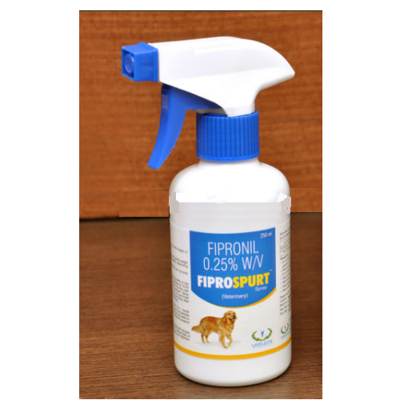
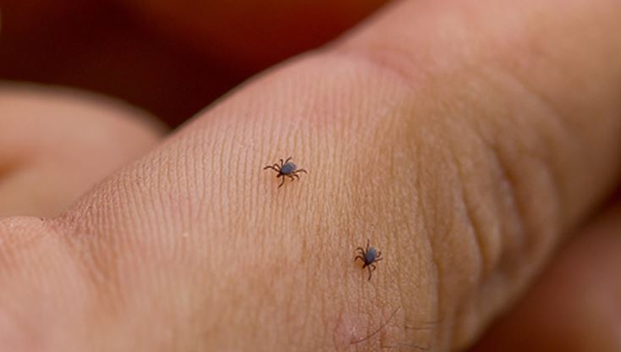
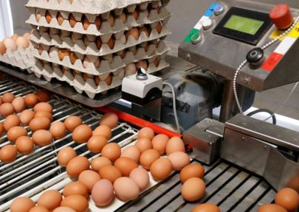



Have you ever also eaten POISON?
Yes, you may have also been contaminated.
Source: https://www.bbc.com/news/world-europe-40878381
Notes:
Have you ever also eaten poison? This spay that you see here is used to kill fleas, but it is also effective at treating red lice on chicken. It’s a pesticide that in humans can cause nausea, vomiting, dizziness, and this was the reason why in 2017 millions of eggs were withdrawn from the supermarket shelves all across Europe.

Slide 3









Problem
Notes:
Let me introduce you to Maria. A young person who has a healthy lifestyle, likes to eat fresh food, but has little time. On the other hand, Carlos is a producer, a small farmer close to the city, but with no visibility online. Here is were Alimentos.pe is the solution.

Slide 4

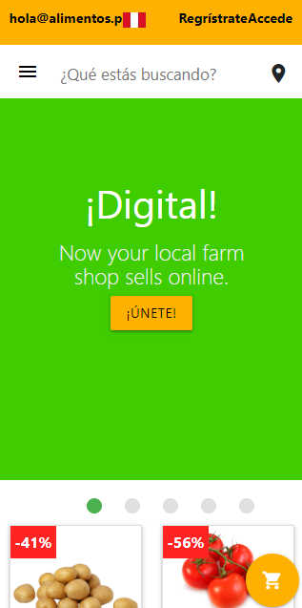







Solution
Notes:
We are an online marketplace that connects customers directly to producers. On one side, customers gets very healthy food delivered to them directly from the producers, and supports a small local business. On the other side, producers gets online visivility, which translates to more sales, and gets basic analytics in sense of having transparency about how much did they sold.

Slide 5
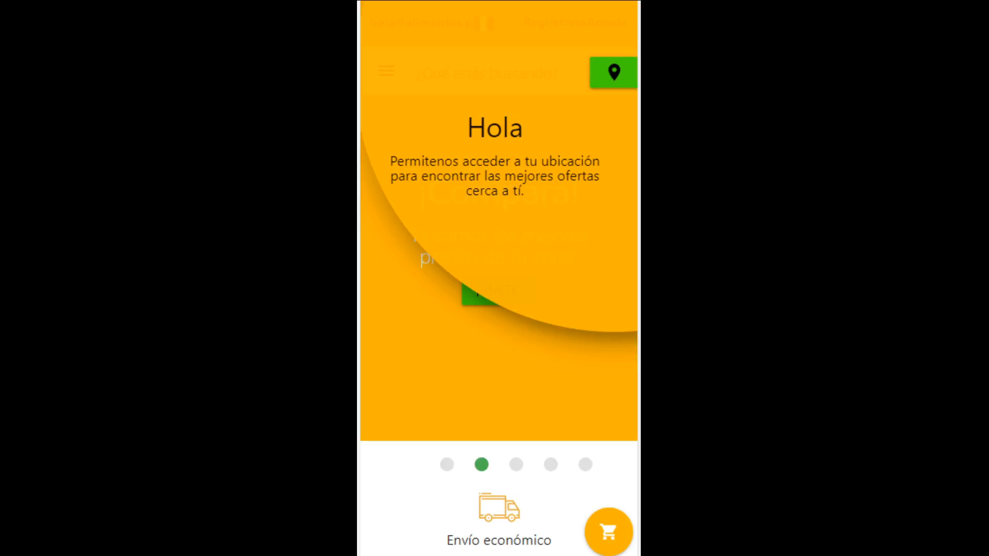
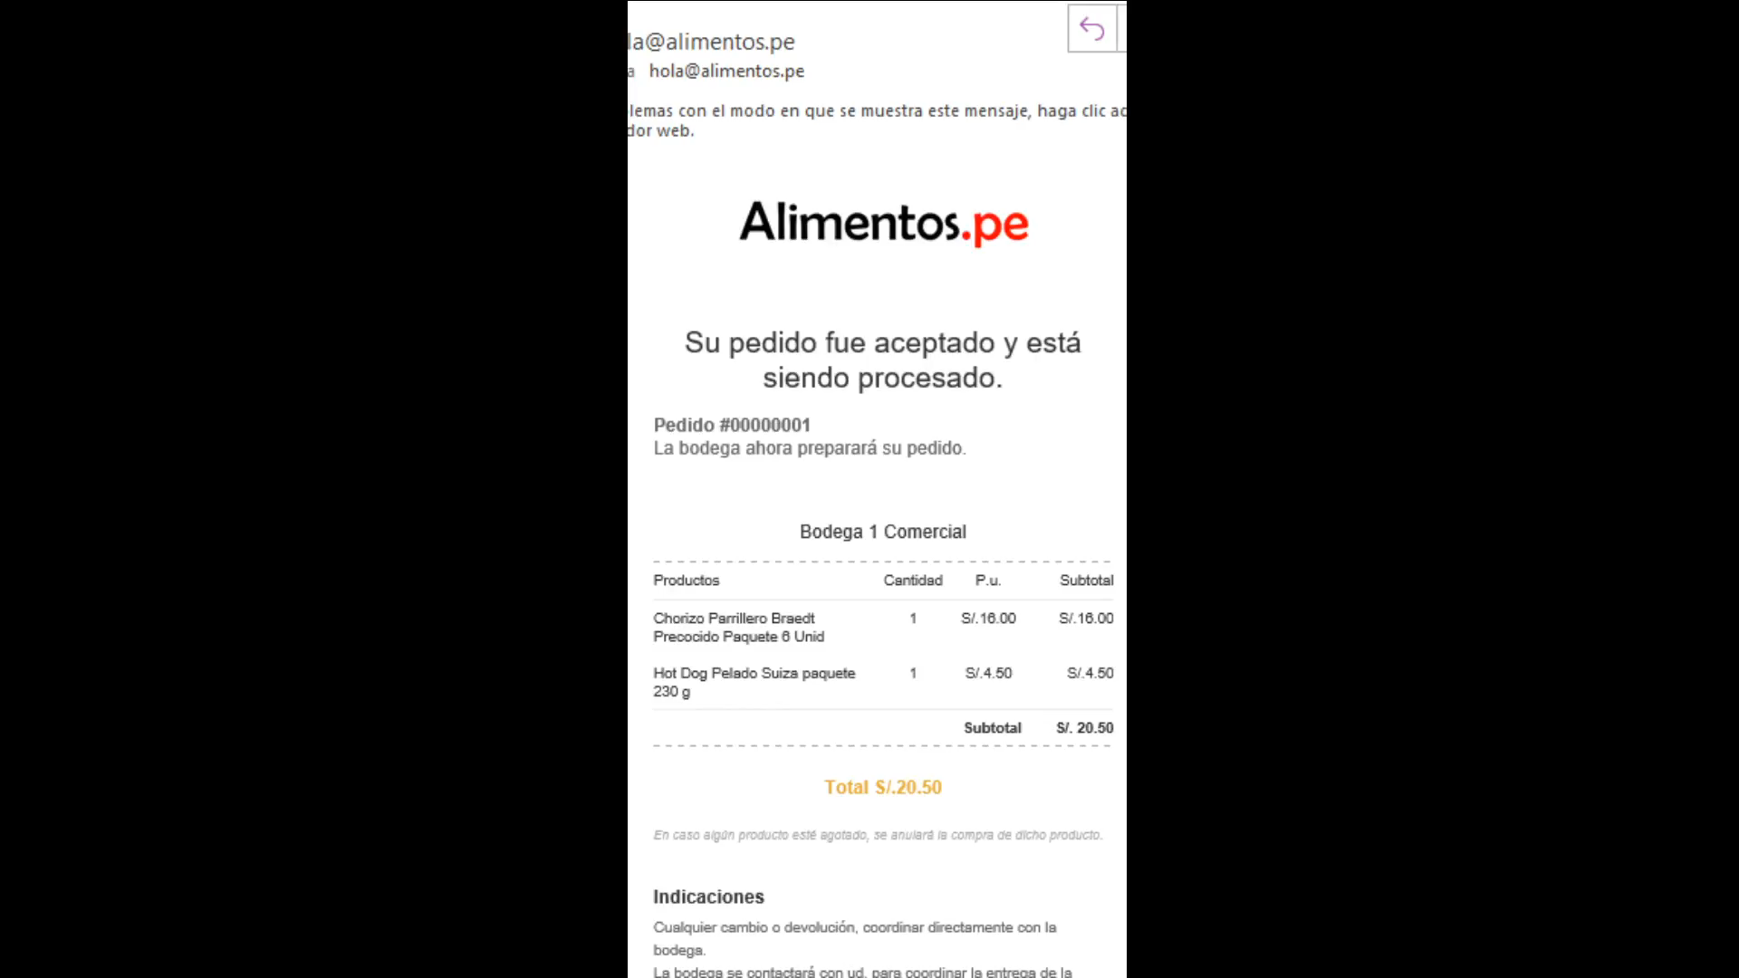
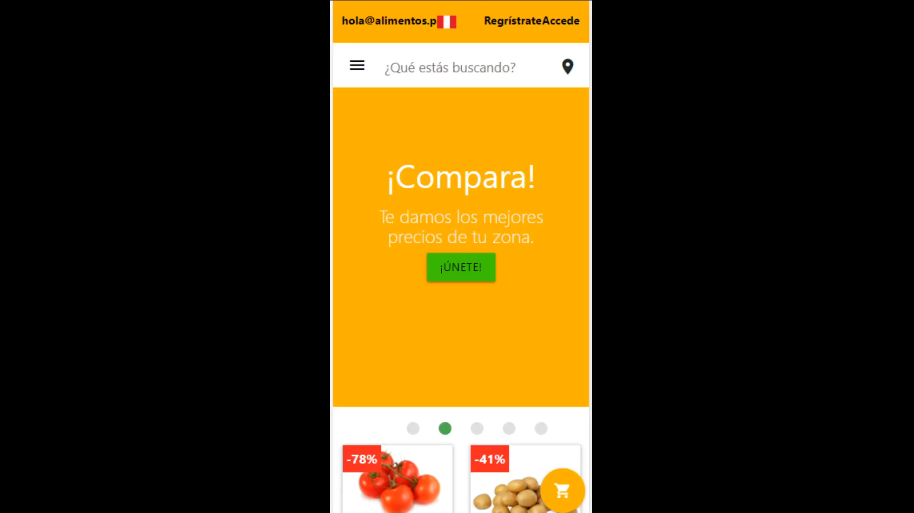

Demo
Little languange vacaciones!
Notes:
This is our prototype. You are asked to enter your location to get the product availability and deals from the shops closed to you. Then, you can choose the products that you want and review them in your cart.
Proceed to the checkout and our algorith will select automatically the farm shop that gives you the best deal for your product selection. When accepting, you and also the producer will receive an email confirming your purchase, and you both will receive each other contact information for getting a personalized attention.
As a small farm shop owner you can login to your account. First you get first insights about how much did you sale the current day, week and month. Also you can manage your products’ prices, if they are available, and offer discounts as you need.

Slide 6
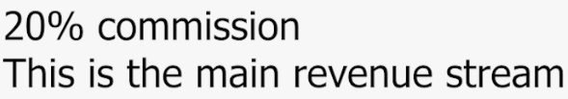

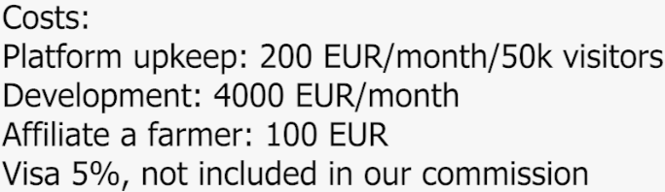

Business model
+
Larger farms excess of production
Sales in the platform
Commission
Notes:
We allow the local producers to keep almost full control of their business. They handle the deliveries and get all the contact information of the buyers after every sale.
We monetize via commission on sales. On one side, we get 1% of what is sold in the platform via single time sales and subscription based ones. And on the other side, we allow larger farms to sell their excess of products directly to our community of small producers, which is skipping almost all the whole supply chain.

Slide 7
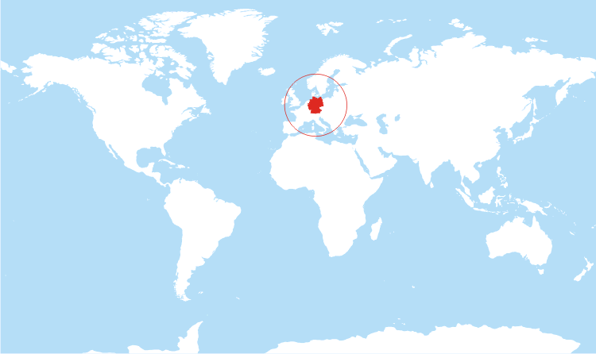

Go-to-the-market
Notes:
We want the producer to remain in our platform by testing theirselves the benefits of selling online. So we have implemented a Zoom-Like business model. Sale for free one month, and don’t sale the next one. But if you want to have an uninterrupted experience, pay us a small commission on your sales.
We are a global start-up based in Berlin, in the middle of the excellent German working culture as well as talent for AI. And our first entry market is Spain because of the language and cultural bonds of our team, which makes us easier to build relationships with the local farmers.
We have validated that this is a global problem and we want to scale doing partnerships with other local visionaries who can empathise well with the producers in their regions.

Slide 8
Market size
37 Billion €
1 Trillion €
>2 Trillion €
Spain
Europe
Global
5%
Source:
https://op.europa.eu/en/publication-detail/-/publication/f08f5f20-ef62-11e6-8a35-01aa75ed71a1
Notes:
The agricultural business is enormous. Everyone need to eat. We want later to expand to Europe, and then world wide. Imagine just capturing 5% of that market. That’s our entry target.

Slide 9





Marketplaces for D2C
Unhealthy food
Everything
Healthy food
Notes:
We are not alone. Recently the Direct To Consumer Marketplace is booming. We differentiate ourselves by focussing only on healthy food market.

Slide 10
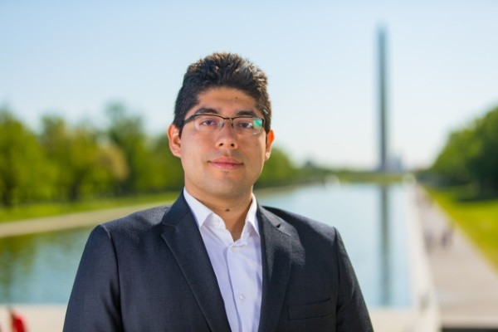
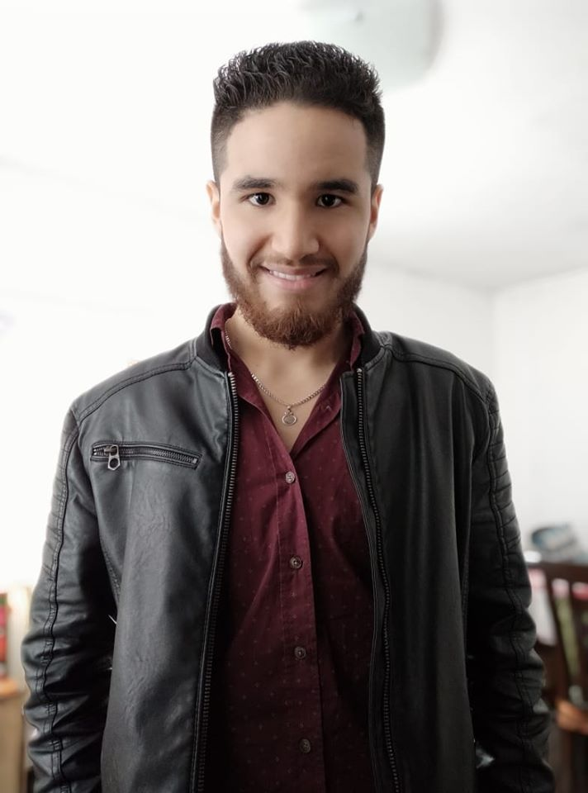
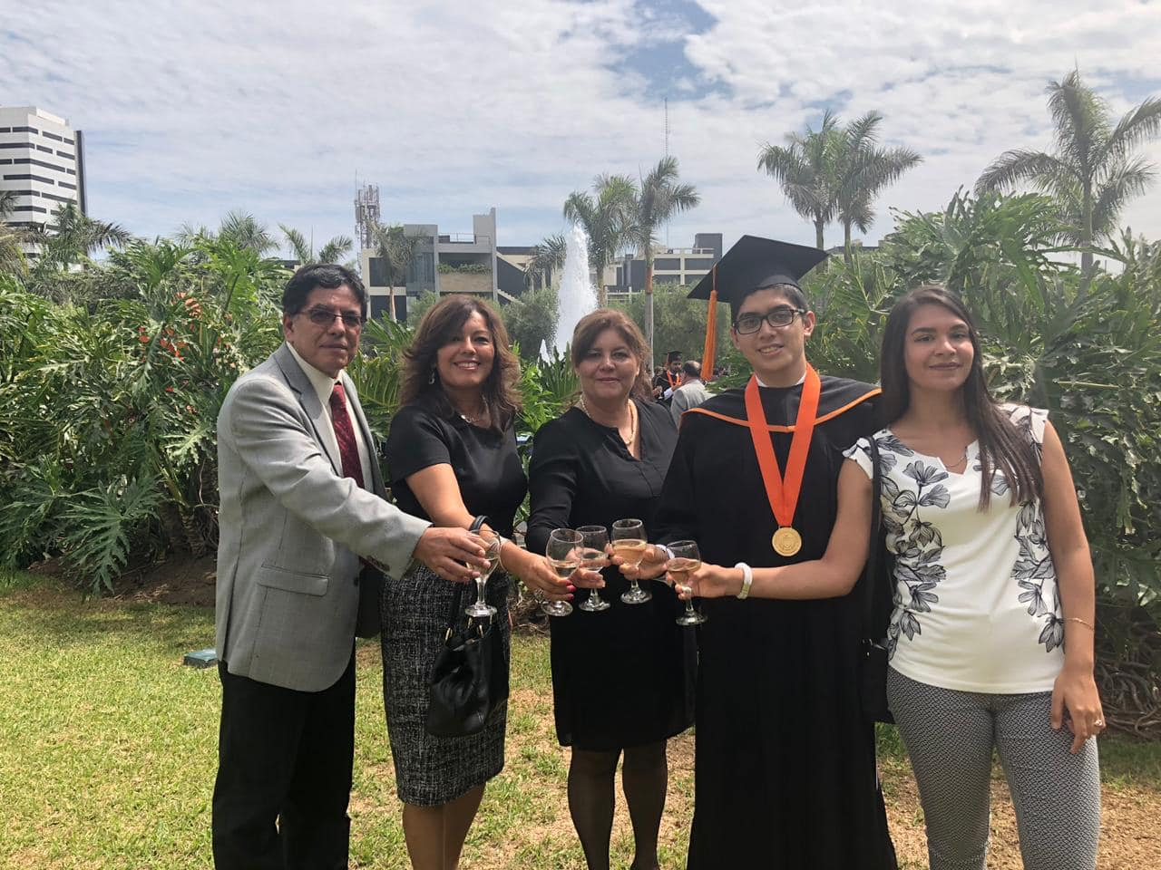
Team
CEO - Diego Guillen (EIT)
M.Sc. Autonomous Systems
Full-stack developer
CTO - Benghir Tello
M.Sc. Data Science
Telecomuminaction Eng.
COO - Carola Rosaperez
Economist / Independent real-state agent
+10y generating trust in people
Notes:
We have a interdisciplinary team and experienced entrepreneurs capable of building a very top-notch modern platform, and establishing strong relationships with our local farmers.

Slide 11
Contact:
Diego Guillen - CEO
hola@alimentos.pe
Notes:
Thank you.

